Slide 1
IA512002
Fundamentals of Web Development
23-AIC-01
February 2023

Slide 2
Week 1: Introduction to Web
Understanding how the web works
Brief internet history
WWW Overview
Dev. environment preparation

Slide 3
How does the internet work?
https://www.youtube.com/watch?v=qEdv_pem-JM

Slide 4

Brief history
1969 – ARPANET
1971 – email
1972 – telnet
1973 – FTP
1977 – mailing list
1979 – Usenet, uucp
1981 – BITNET
1982/3 – TCP/IP
1984 – DNS
1986 – NSFNET
1991 – WWW
2000 – Web2 + social media

Slide 5
What is internet?
Internal structure
Data transmission
Capacity (effectiveness)
Data recovery, outages, delay
Fairness
Reliability
Decentralized administration (ex – Mesh topology)

Slide 6
Networks
Types of Networks
PAN (Personal Area Network)
LAN (Local Area Network)
MAN (Metropolitan Area Network)
WAN (Wide Area Network)
Different network connections
Peer-2-peer
Client-server

Slide 7
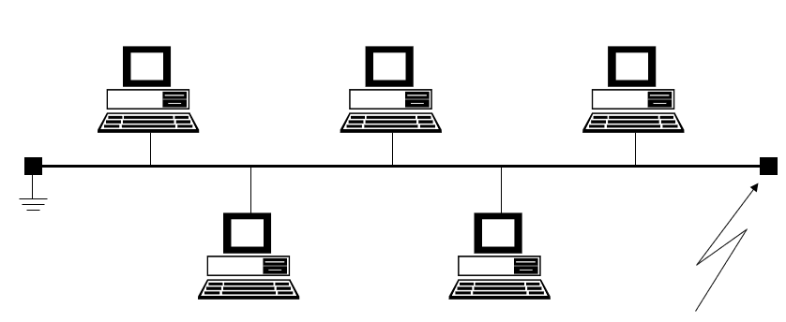
Network Topologies - Bus

Slide 8
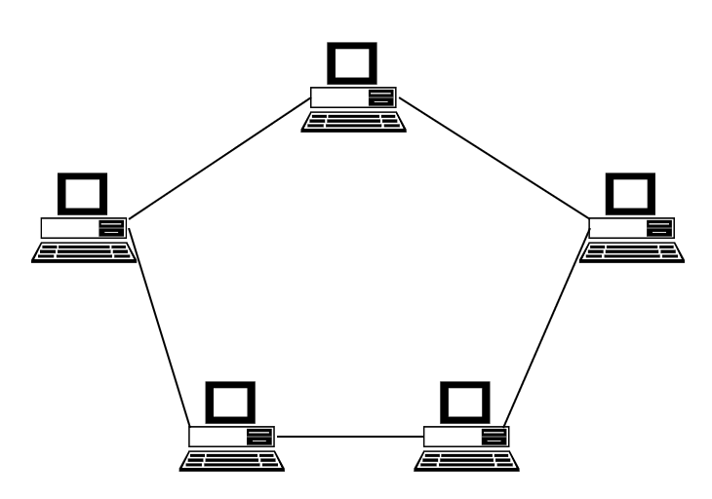
Network Topologies - Ring

Slide 9
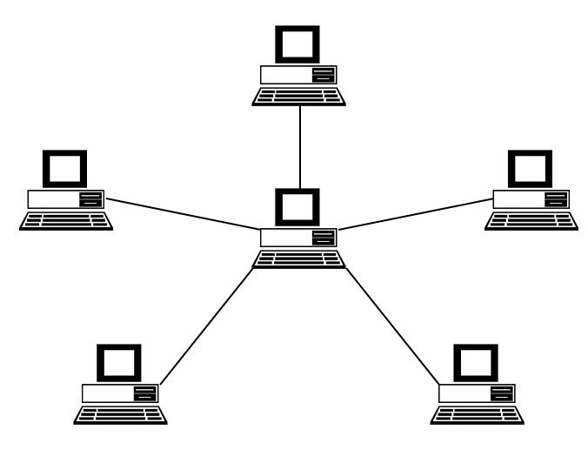
Networks Topologies - Star

Slide 10
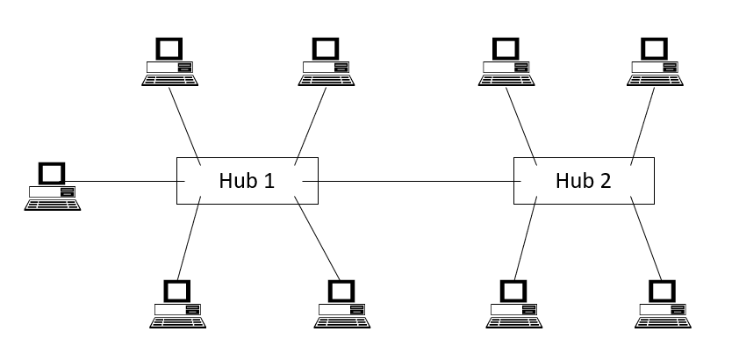
Network Topologies - Hybrid

Slide 11
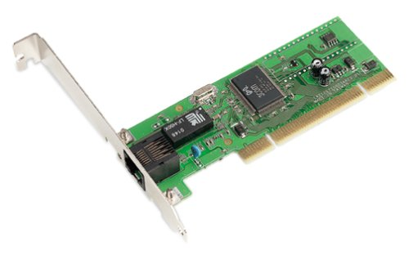
Networks
Network Interface Card = NIC

Slide 12
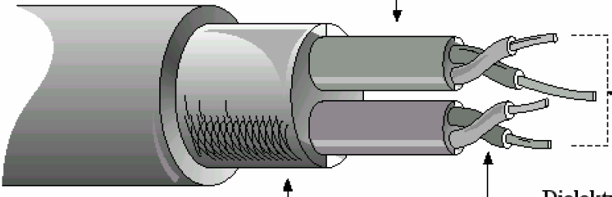
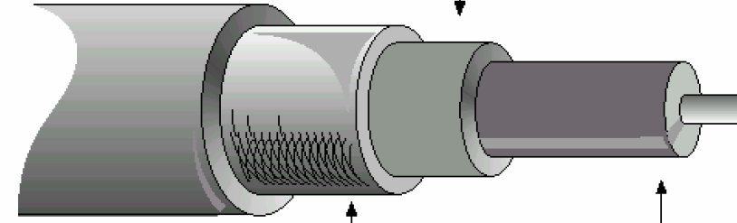
Networks
Transport medium

Slide 13
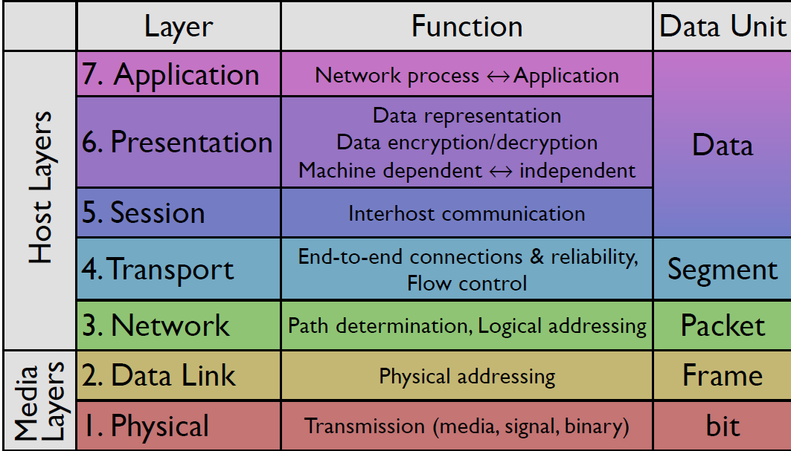
Open Systems Interconnection(OSI) Model

Slide 14
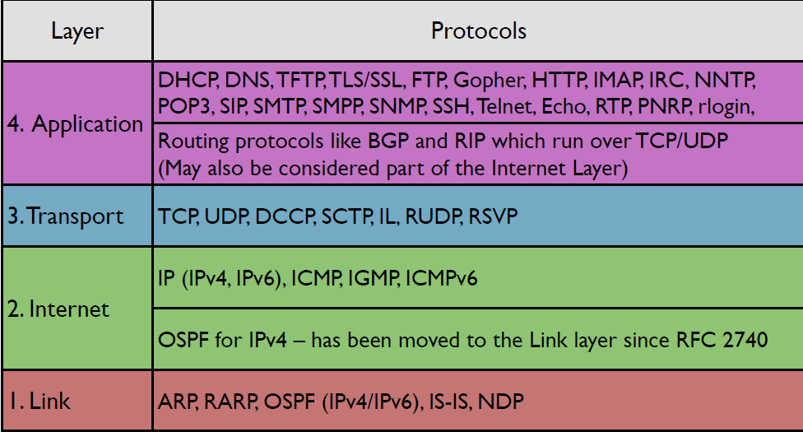
Internet Protocol Suite

Slide 15
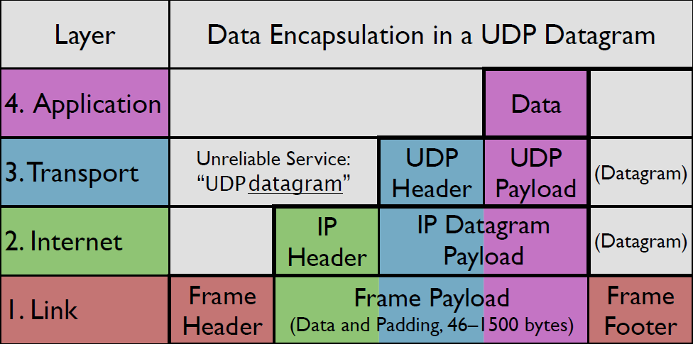
Data Encapsulations

Slide 16
Web related terms
Client
Server
Packet
…

Slide 17
IP
Internet protocol
32bit IPv4
128bit IPv6

Slide 18
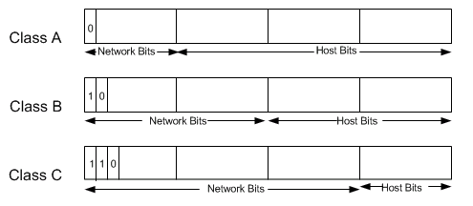
IP

Slide 19
TCP
Transmission Control Protocol
Segments
If there is a connection, no package loss or data damage
Confirmations
Error detection, state detection

Slide 20
ICMP
Internet Control Message Protocol
Control information for IP
Error detection, state detection

Slide 21
DHCP
Dynamic Host Configuration Protocol
Allows a computer in a LAN to become configured automatically
Maintains a database for keeping track of connected computers

Slide 22
Firewall
Block unauthorized access
Permit authorized communications
Often provide NAT and DHCP

Slide 23
Routing
Static vs dynamic
Static –Manually configure and select network route
Dynamic – Create and update routing tables run time
Distributed vs centralized
Centralized – One central node hold the routing table
Distributed – Each node keeps a routing table
Source based vs step-by-step
Deterministic vs stochastic

Slide 24
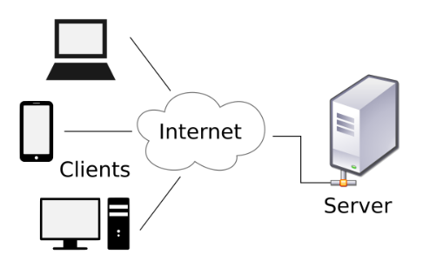
What happened when you visit a website?

Slide 25
Frontend/Backend/Full-stack
http://ddi-dev.com/blog/programming/backend-and-frontend-web-development-comparison/

Slide 26
Development tools
Editor, IDE
Browser
Dev. tools
Versioning system

Slide 27
GIT
Is an open-source project originally developed in 2005 by Linus Torvalds, the creator of the Linux Kernel and is the most widely used Version Control System (VCS).

Slide 28

Questions?

